Slide 1

Latent Paraphrasing: Perturbation on Layers Improves Knowledge Injection in Language Models
NeurIPS 2024
November 08, 2024
UNIST Language & Intelligence Lab
Chanbin Lee

Slide 2
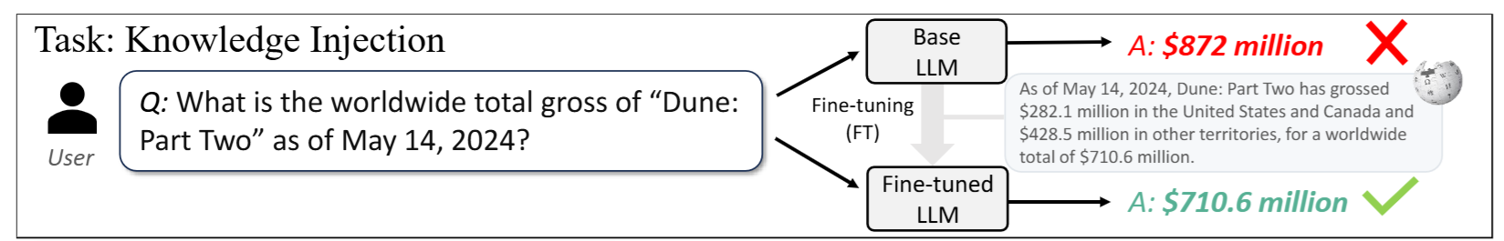

Introduction
Knowledge in LLMs is static, and LLMs often lack specificity for specialized or private domains
Even fine-tuning LLMs on a “single document” doesn’t allow them to fully internalize its knowledge.

Slide 3
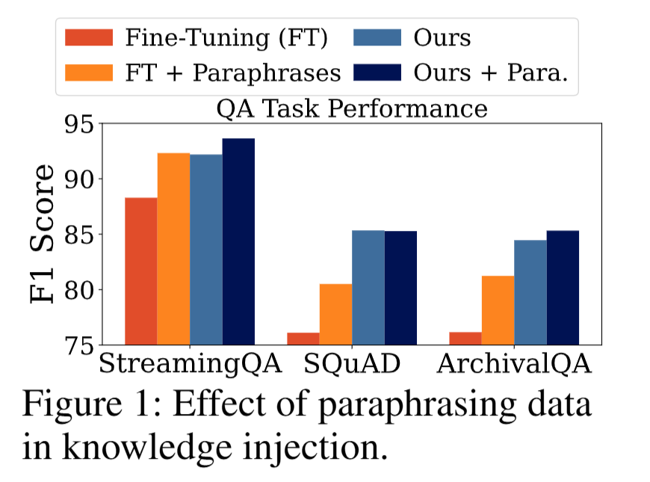
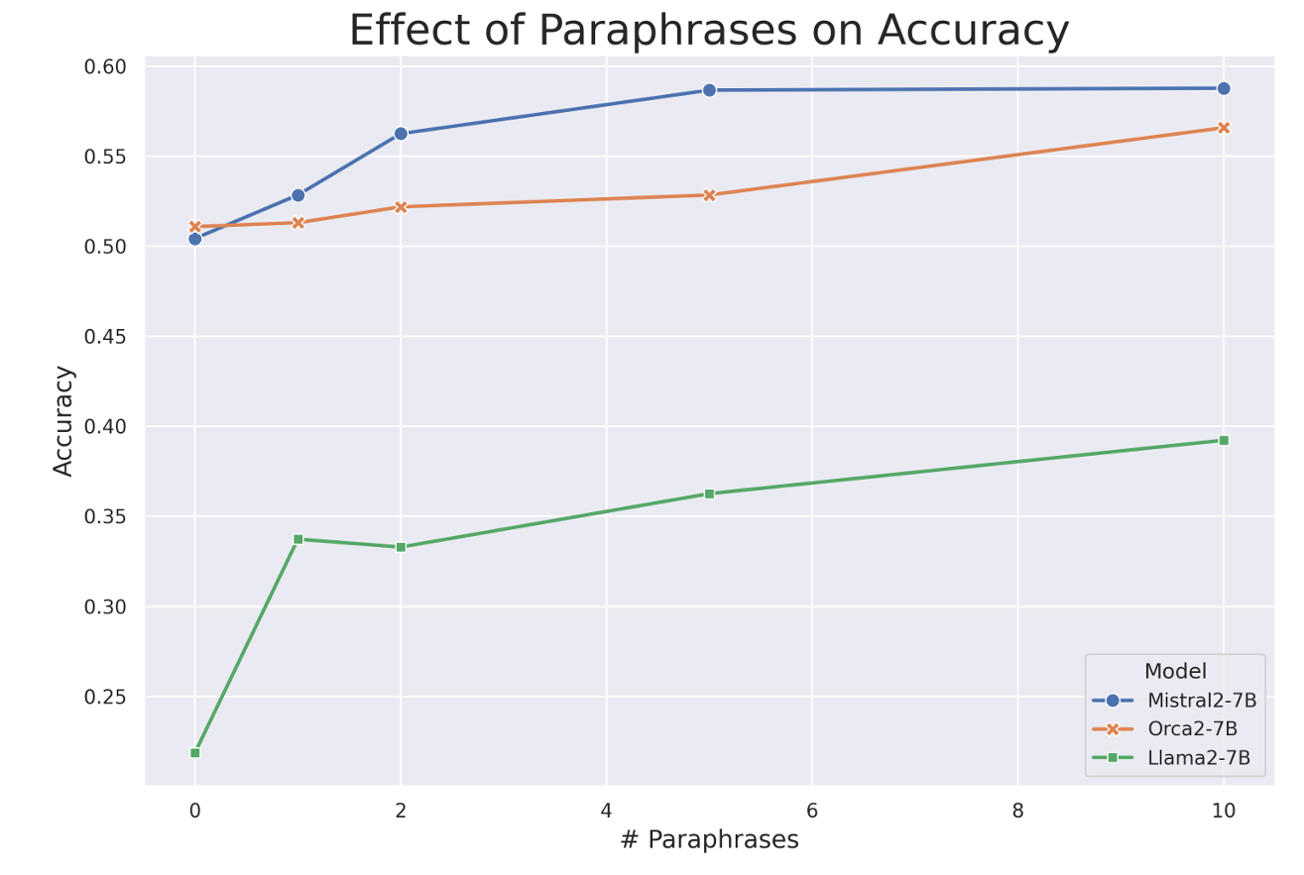
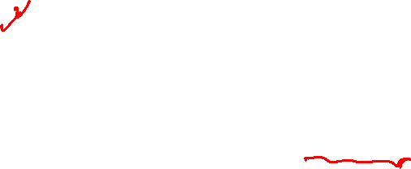
Introduction
Data augmentation, such as paraphrasing, is a simple yet effective way to enhance knowledge injection
Limitations:
High computational cost: need to repeatedly generate paraphrases for each document with the new incoming knowledge
Limited diversity in augmented data: LLMs produce narrow range of augmented samples at the discrete data level
Ovadia et al., 2023

Slide 4
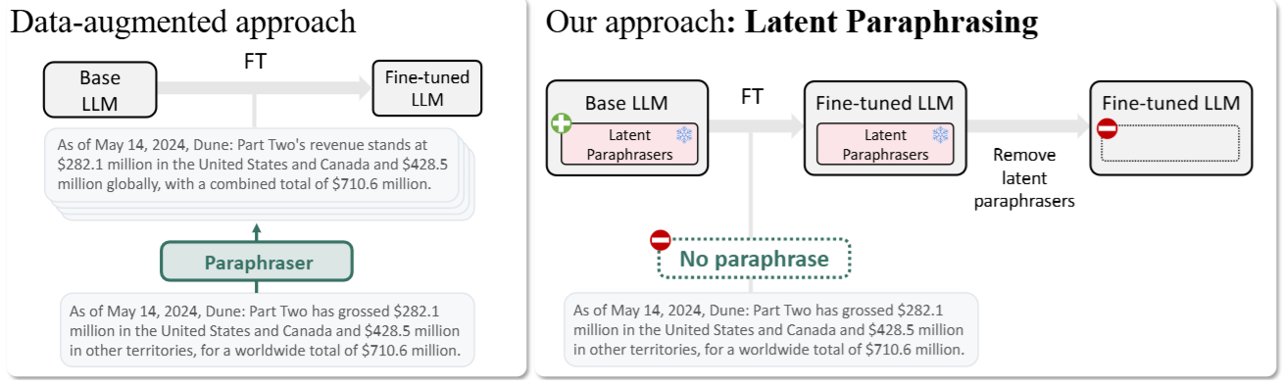
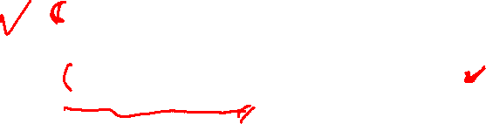
Introduction
Contributions
LaPael: a new method that applies learned perturbations to the layers of LLMs to enhance knowledge injection, addressing the limitations of data augmentations and noise baselines.
LaPael achieves a significant improvement in knowledge injection performance compared to standard fine-tuning, on diverse question-answering benchmark datasets.
LaPael not only outperforms fine-tuning with paraphrases but also complements it, providing additional benefits when used together, surpassing the performance of existing latent noise-based methods.

Slide 5
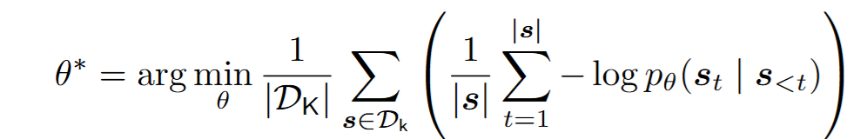


Problem Formulation
Documents $D_{K}$ containing knowledge that we are interested to inject
Q&A dataset $D_{QA}$= ${\left\{\left(q^{\left(i\right)}, a^{\left(i\right)}\right)\right\}}_{i=1}^{n}$ for verifying injected knowledge from $D_{K}$
“Finetuning” in this paper means unsupervised; training the whole document with LM objective.

Slide 6

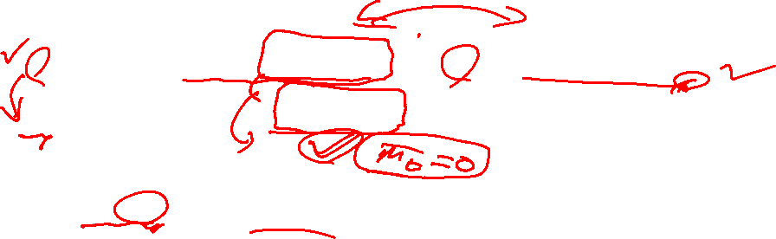
Method – Training Data
To train latent paraphrasers, we need distinct set of training data $D_{train}={\left\{s^{\left(i\right)}\right\}}_{i=1}^{N}$ which consists of documents having different knowledge with $D_{K}$
ex)
For $s=\left(x,y\right)$, generate K paraphrases for each sentence →${\left\{{\left\{\left(x_{k}^{(i)}, y^{(i)}\right)\right\}}_{k=1}^{K}\right\}}_{i=1}^{N}$

Slide 7
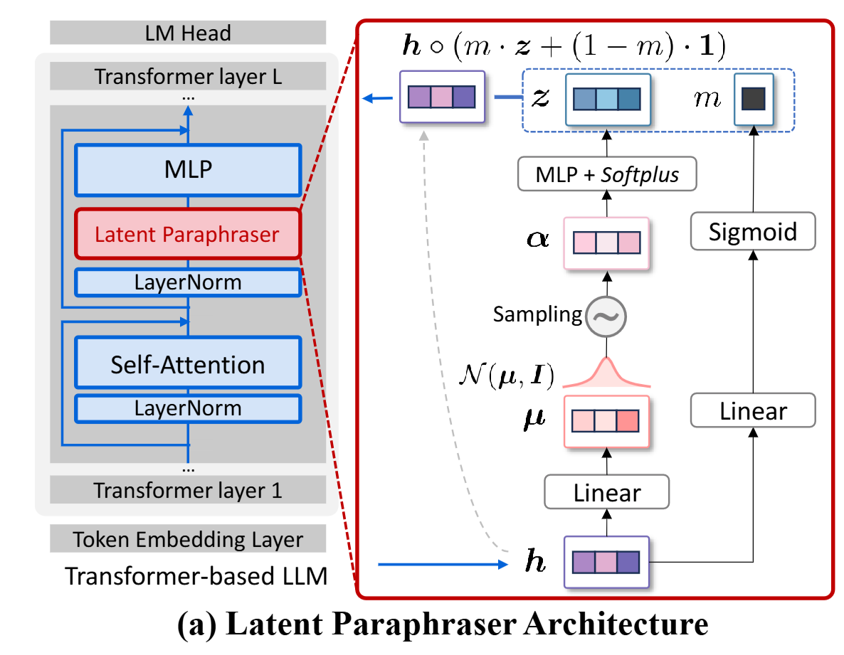

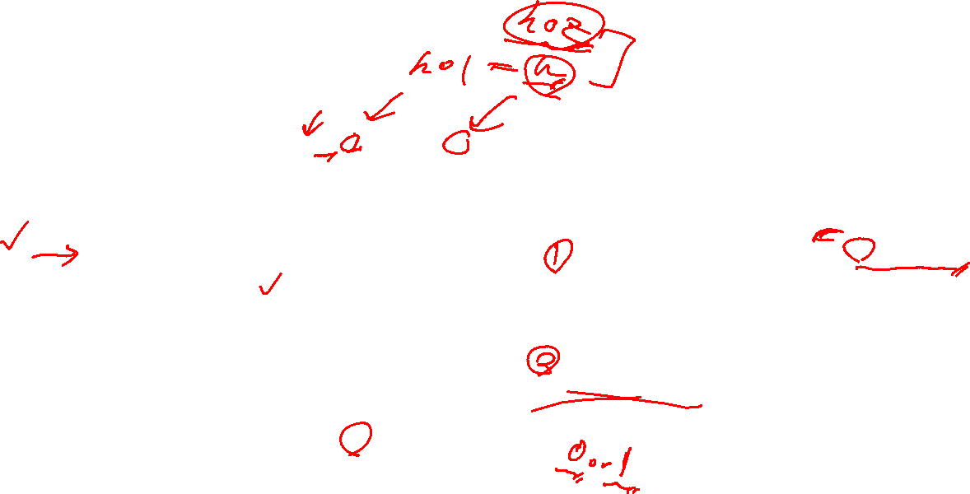
Method – Latent Paraphraser
latent paraphraser modifies the internal features (representations) of text within the model instead of generating explicit, surface-level paraphrases.
sample $α$, get noise vector $z$
Element-wise multiplied with $h$ after masking
We want binary masks
This trick allows differentiation

Slide 8
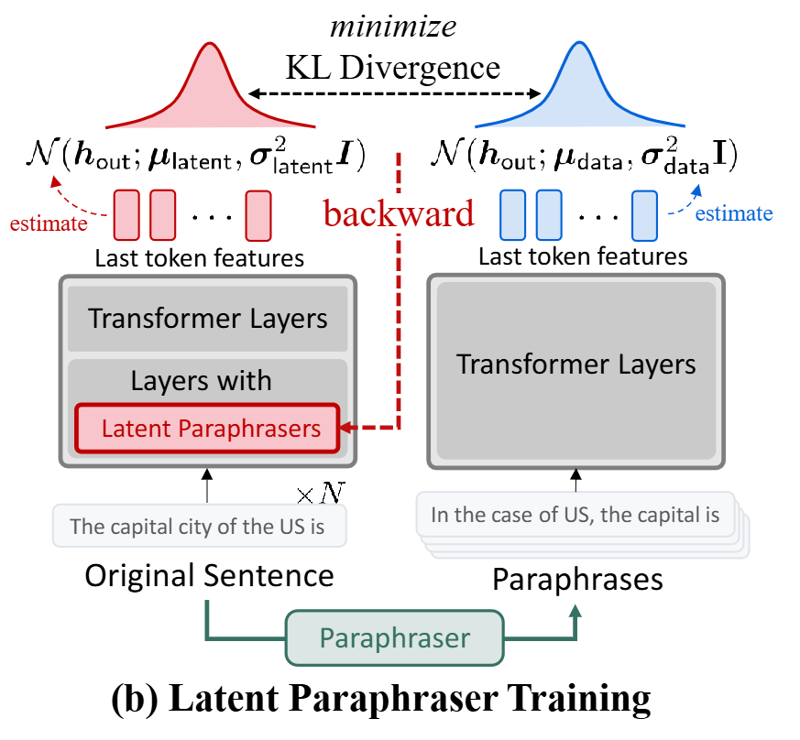
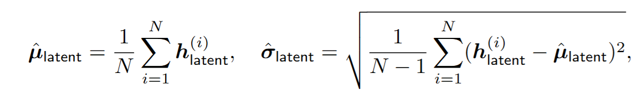
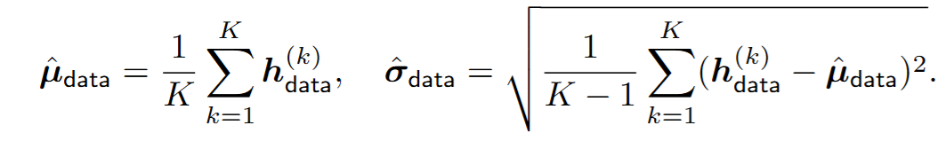
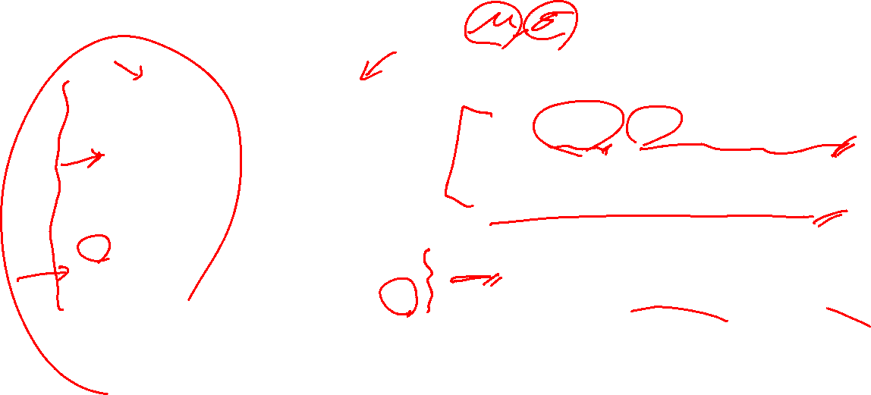
Method – Latent Paraphraser
Assumption that both distributions are Gaussian
Match the distribution of
Latently perturbed features
Paraphrased inputs’ features

Slide 9
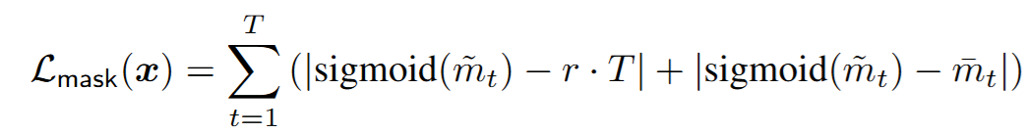
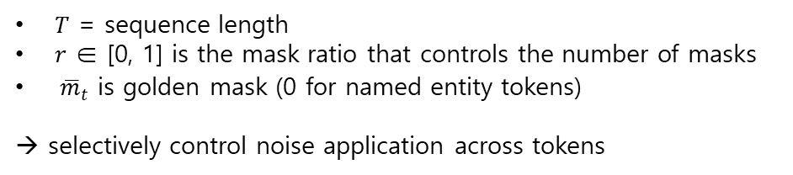
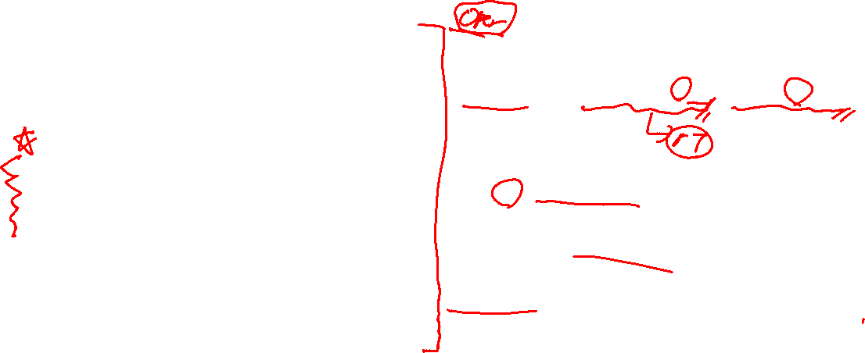
Method – Latent Paraphraser
$T$ = sequence length
$r$ ∈ [0, 1] is the mask ratio that controls the number of masks
${\overline{m}}_{t}$ is golden mask (0 for named entity tokens)
→ selectively control noise application across tokens

Slide 10

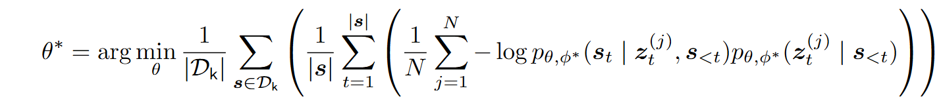
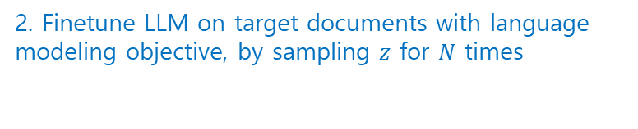
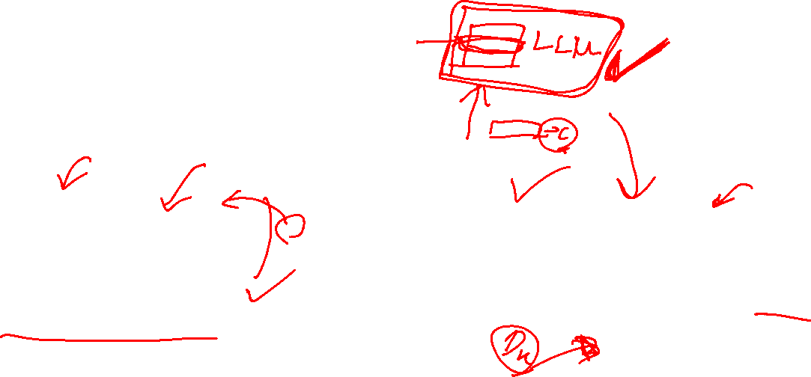
Method – Latent Paraphraser
1. Train Latent Paraphraser. Once trained, this can be used for finetuning any documents.
2. Finetune LLM on target documents with language modeling objective, by sampling $z$ for $N$ times

Slide 11
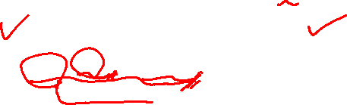

Experiments
1. Raw Documents Setting
In this setting, the documents in $D_{K}$​ are presented to the model in their original format as they would be found in a real-world context.
SQuAD, StreamingQA, ArchivalQA
+ Films 2024, Events2024 (GPT-generated, unseen during LLM pretraining)

Slide 12
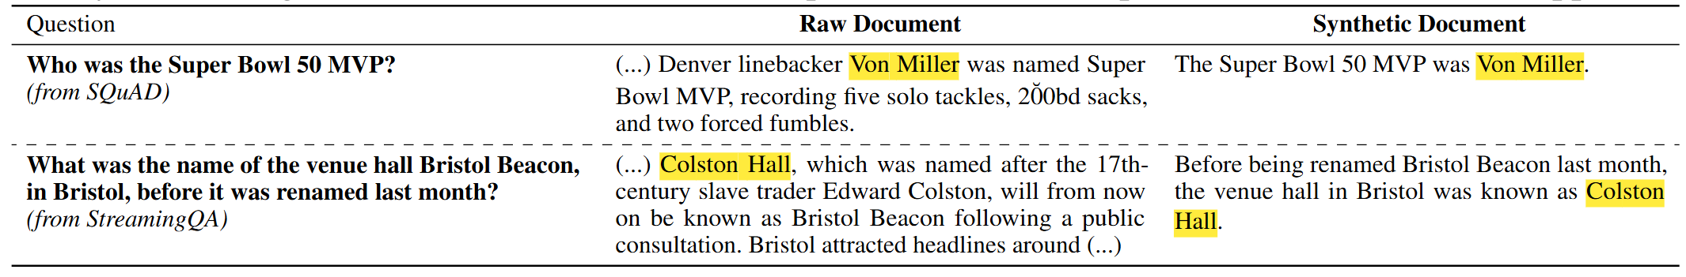
Experiments
2. Synthetic Documents Setting (denoted by the suffix -syn):
Raw documents often contain additional or extraneous information not directly related to the QA tasks.
makes difficult to measure how well the knowledge injection method works
Generate synthetic documents by rephrasing each QA pair, ensuring that the knowledge needed to answer each question is present in a precise and answerable format.

Slide 13
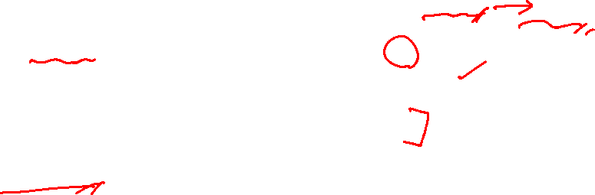
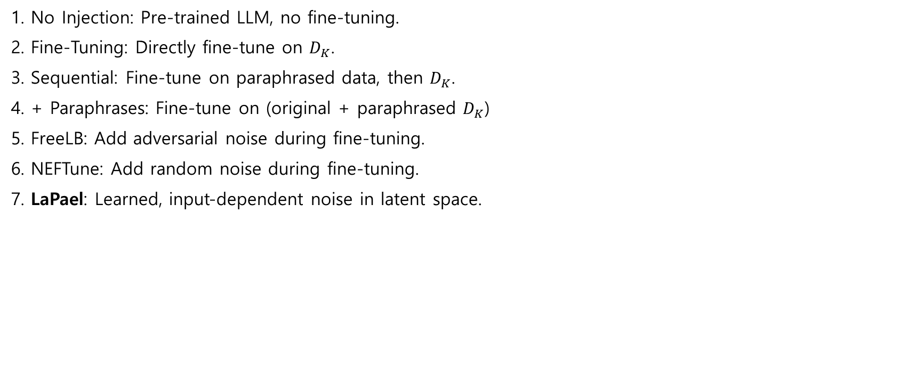
Experiments – Baselines
1. No Injection: Pre-trained LLM, no fine-tuning.
2. Fine-Tuning: Directly fine-tune on $D_{K}$.
3. Sequential: Fine-tune on paraphrased data, then $D_{K}$.
4. + Paraphrases: Fine-tune on (original + paraphrased $D_{K}$)
5. FreeLB: Add adversarial noise during fine-tuning.
6. NEFTune: Add random noise during fine-tuning.
7. LaPael: Learned, input-dependent noise in latent space.

Slide 14
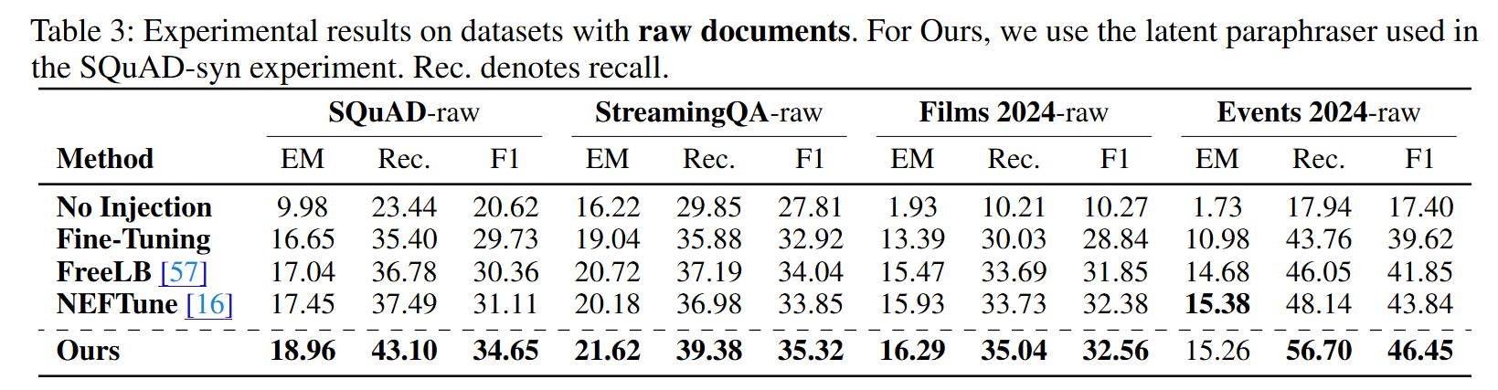
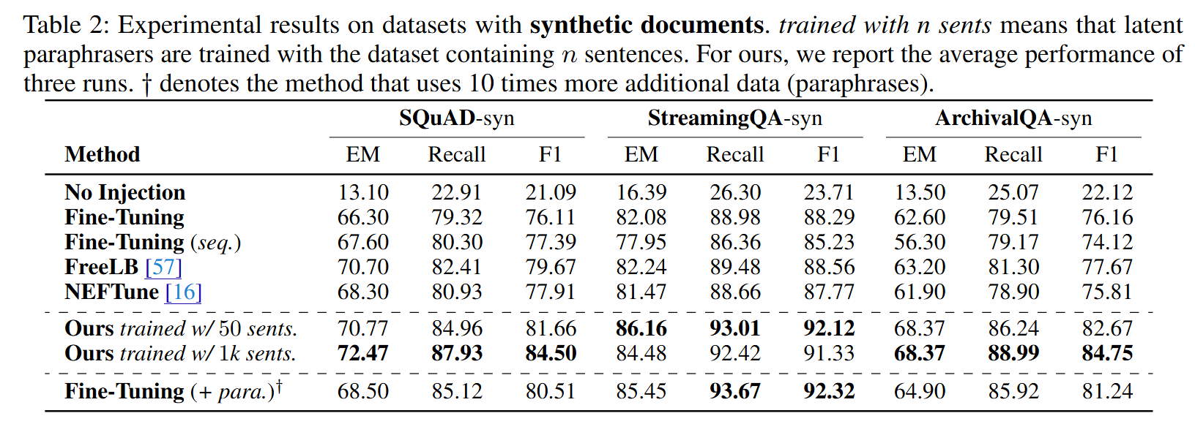
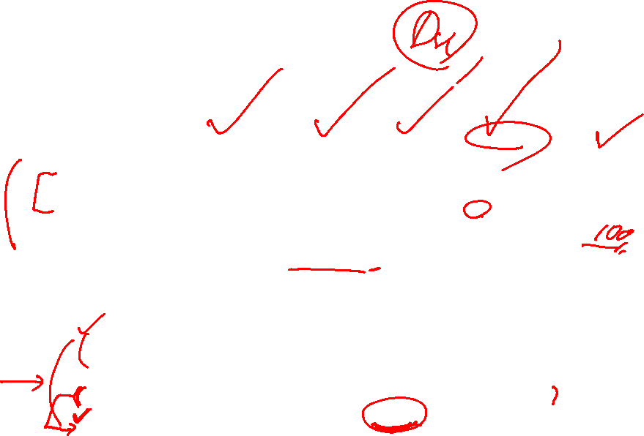
Experiments - Results

Slide 15
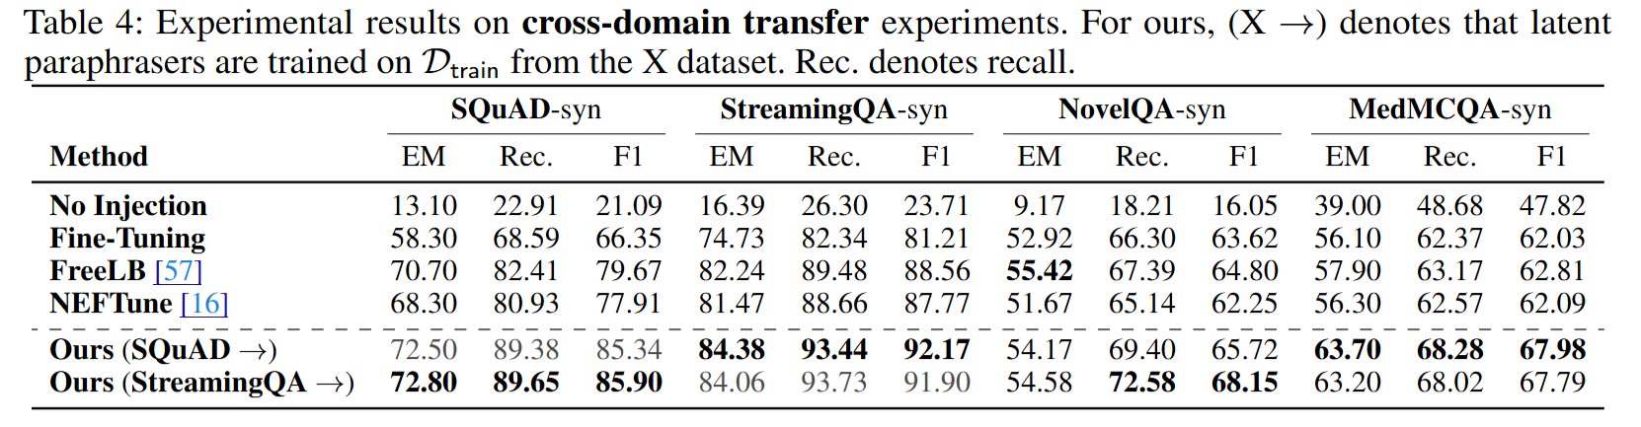
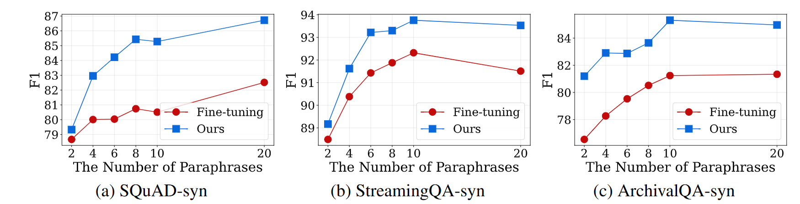
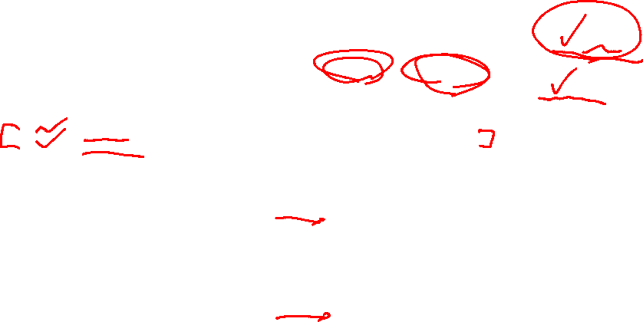
Experiments - Results
Successfully transfers across domains
(NovelQA and MedMCQA – two domains distinct from the source)
Works well together with paraphrasing, while consistently outperforming standard fine-tuning

Slide 16
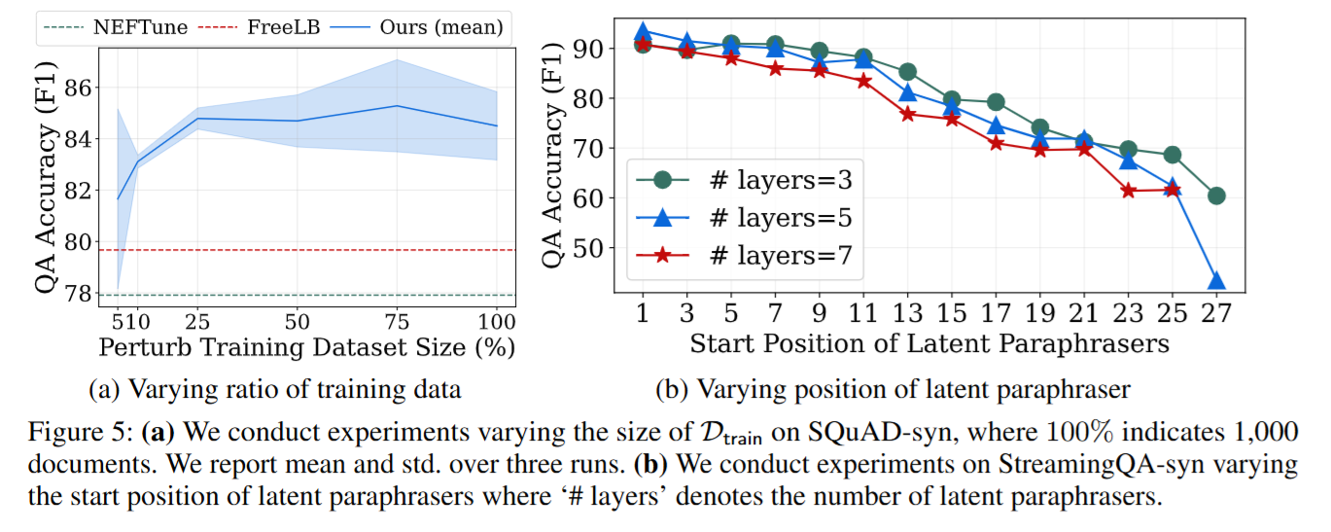
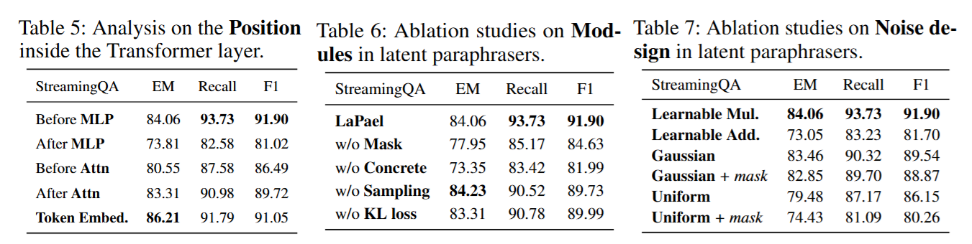
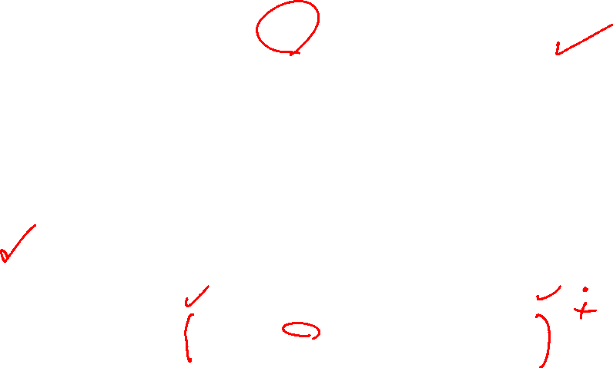
Experiments – Ablation studies

Slide 17
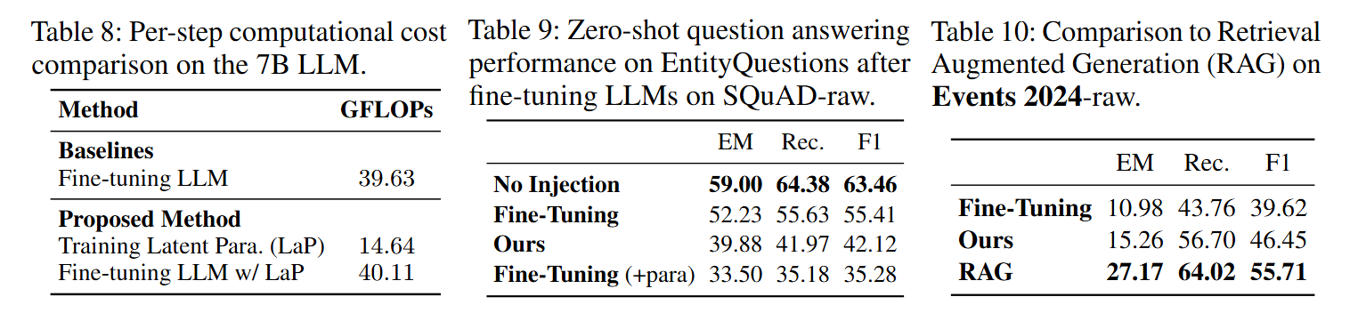
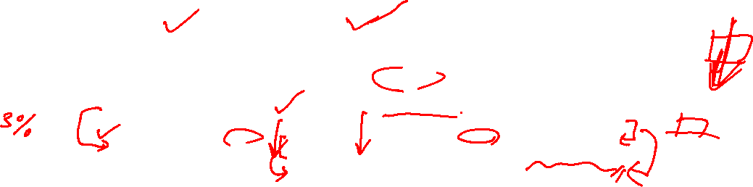
Discussions & Limitations
Needs initial computation for traning latent paraphrasers, but adds only a minimal computational overhead after.
Improved Injection → Greater Forgetting
Fine-tuning simplifies generation pipeline, but RAG always outperforms fine-tuning.

Slide 18
THANK YOU

